Slide 1

E-Commerce Growth & Conversion Intelligence
CasE Study :- BearCart (E-Commerce Company)
MODEL MINDS
PRESENTATION
“Big data is at the foundation of all the megatrends that are happening today, from social to mobile to cloud to gaming.”
Team members
Salman Shaikh – Main Brain
Dhruvi Parekh – Sharp thinker
Vyanka tRathod – Code mind
Lokendra Khadka – Analyzing king
Suraj Nirgun – Debugging king
College Name:
Imarticus Learing

Slide 2


BUSINESS CONTEXT & PROBLEM UNDERSTANDING
Problem Statments
To analyze e-commerce data to identify key drivers of traffic, conversion, and revenue, and provide data-driven business recommendations using dashboards.
BearCart is an online retailer with growing digital traffic
Large datasets available but limited actionable insights
CORE PROBLEM
High website traffic but low conversion rate
Need to understand where users drop off
Optimize marketing spend, conversion funnel, and revenue growth
OBJECTIVE
Transform raw data into clear insights and recommendations

Slide 3


DATA OVERVIEW & PREPARATION
Datasets Used
Sessions
Pageviews
Orders & Order Items
Products
Refunds
Data Time Period
2012 – 2015
Data Preparation Steps
Removed duplicates
Handled missing UTM values
Standardized columns and formats
Created calculated metrics (Revenue, AOV, Conversion Rate)
Outcome
Clean, reliable datasets for accurate analysis

Slide 4



APPROACH & METHODOLOGY
Analysis Approach
Data Cleaning & Validation
KPI Definition
Trend Analysis
Conversion Funnel Analysis
Channel & Device Performance
Product & Refund Analysis
Tools Used
Python (Data Processing & EDA)
Power BI (Interactive Dashboard)

Slide 5

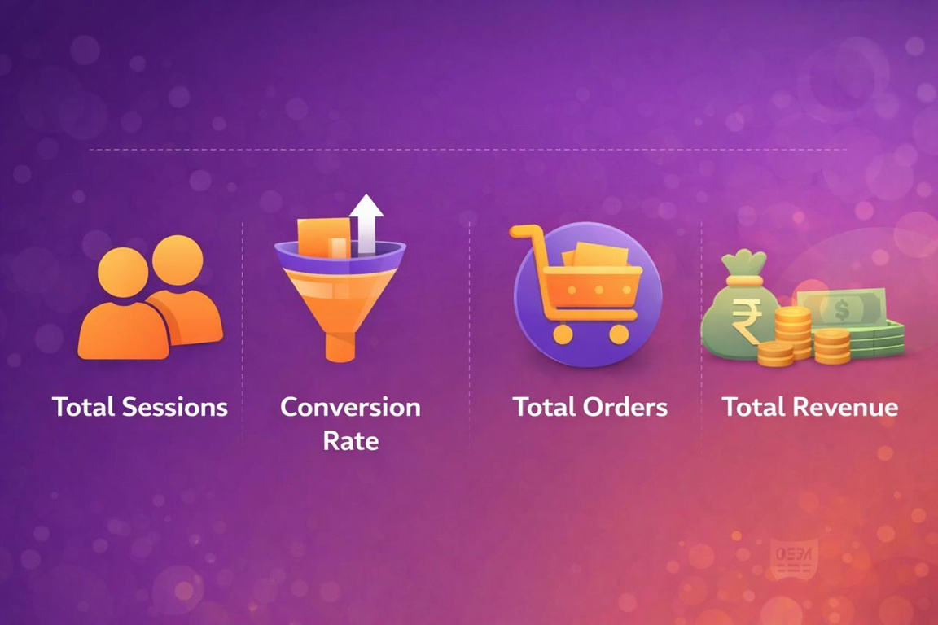
KEY KPIS DEFINED
Core Performance KPIs
Total Sessions
Total Orders
Total Revenue
Average Order Value (AOV)
Conversion Rate
Refund Rate
Total Refund Amount
Why These KPIs Matter
Measure traffic quality
Track revenue efficiency
Identify operational and experience issues

Slide 6

KEY INSIGHTS FROM DATA
Traffic & Revenue
Strong and consistent growth in sessions
Revenue is increasing steadily due to healthy AOV
Conversion
Overall conversion rate 6.83%
Major drop between sessions → completed orders
Devices
Desktop converts significantly better than mobile
Products
One product contributes the majority of revenue
Limited product diversification

Slide 7
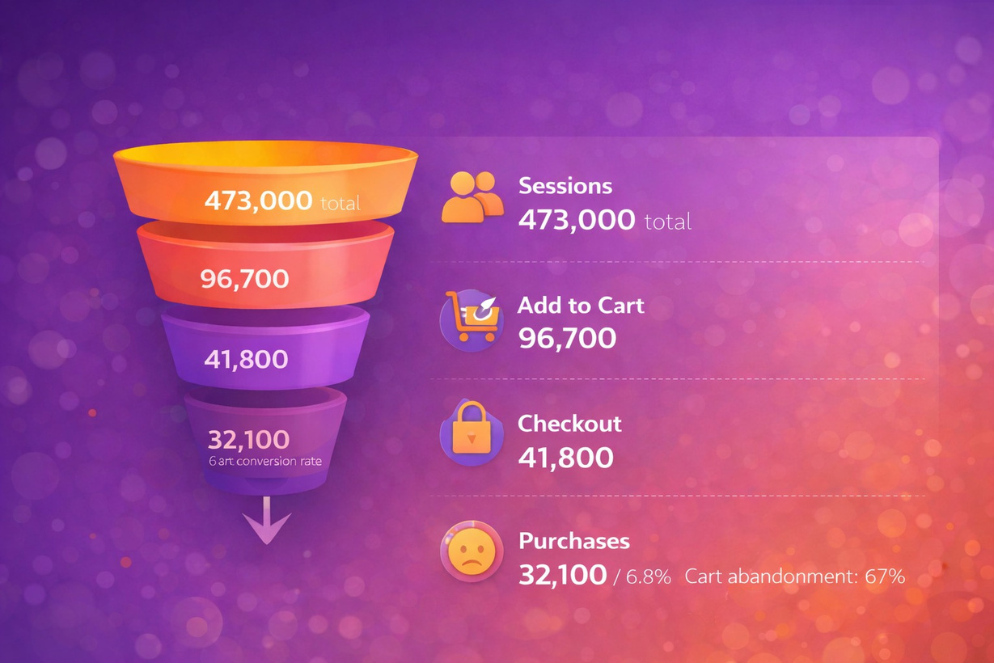
CONVERSION FUNNEL & BEHAVIOR INSIGHTS
Funnel Observation
Significant drop-off from product pages to cart
Another major drop during the checkout stages
User Behavior Insights
Mobile users show higher abandonment
First-time visitors convert less than repeat users
Key Bottleneck
Cart and checkout experience

Slide 8

DASHBOARD HIGHLIGHTS (POWER BI)
Dashboard Features
KPI Cards for instant performance view
Monthly trends for sessions, orders, and revenue
Channel-wise conversion comparison
Device-level performance
Product revenue contribution
Refund rate tracking
Value
Enables quick, data-driven decision making
Easy to interpret for business stakeholders

Slide 9

FINAL BUSINESS RECOMMENDATIONS
Marketing
Shift budget to high-converting channels
Focus on brand campaigns with better ROI
Conversion Optimization
Improve mobile UX and checkout flow
Reduce cart friction and checkout steps
Revenue Growth
Introduce product bundles
Promote top-performing products strategically
Refund Reduction
Improve product quality & expectation setting
Analyze refund reasons regularly

Slide 10
CONCLUSION
Conclusion
Growth opportunity lies in improving conversion efficiency, not just traffic
Small conversion improvements can lead to large revenue gains
Dashboards bridge the gap between data and decisions
We have building a model for future prediction for the upcoming year.
THANK YOU
QUESTIONS & DISCUSSION

